Slide 1

UE22CS320B – Capstone Project Phase – 2
SEMESTER - VI
END SEMESTER ASSESSMENT
Project Title : Generative AI in marketing
Project ID : PW25_SSS_06
Project Guide : Dr. Shylaja S.S
Project Team : Srishti Mathur,Hrishita Patra,Dhruva R Prasad,Suhani Verma

Slide 3
Generative AI in marketing
Outline
Abstract and scope.
Suggestions from phase-2 review 2
Enhanced Literature Survey(if any)
Design Approach.
Design constraints, Assumptions and Dependencies
Architecture
Proposed methodology/Approach
Datasets exploration and Preprocessing
Base Model Implementation
Project Progress Plan for Phase 3 and Phase 4
References
Any other Information

Slide 4
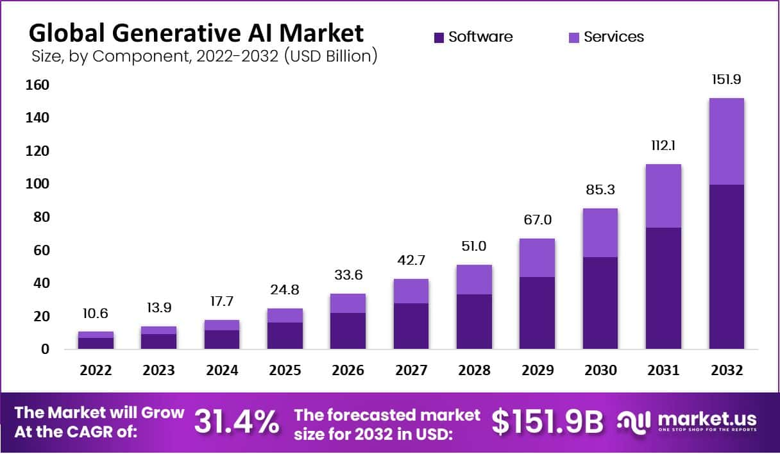
Generative AI in marketing
Abstract and Scope
Highlights the rapid expansion of the global generative AI market, a 14x increase in just a decade.
Generative AI is not just a trend—it’s becoming a core technology with trillion-dollar potential.
Companies investing early will gain a competitive edge in efficiency, creativity, and automation.

Slide 5
Generative AI in marketing
Abstract and Scope
What our project aims to do:-
The user inputs product metadata and metadata through the UI.
Data preprocessing involves masking the product image via thresholding and background removal, then resizing it.
Prompt generation uses product metadata (e.g., color, category) to create a text description for Stable Diffusion, ensuring the background is abstract and product-appropriate.

Slide 6
Generative AI in marketing
Abstract and Scope
What our project aims to do:-
The final output composites the product onto the AI-generated background using object detection and placement optimization to avoid overlaps and enhance visual appeal.

Slide 7
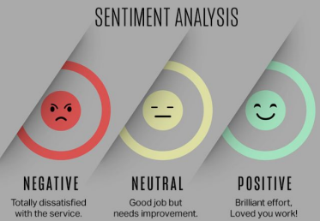
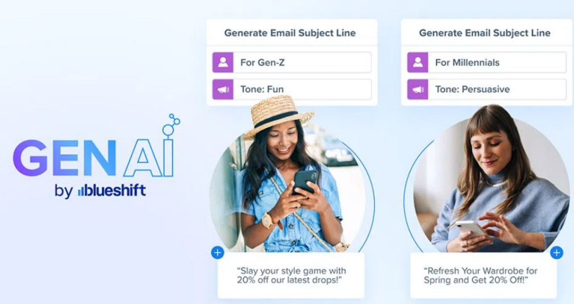
Generative AI in marketing
Abstract and Scope
The Gen-AI Marketing Project aims to integrate artificial intelligence (AI) and machine learning (ML) into key marketing operations such as:-

Slide 8
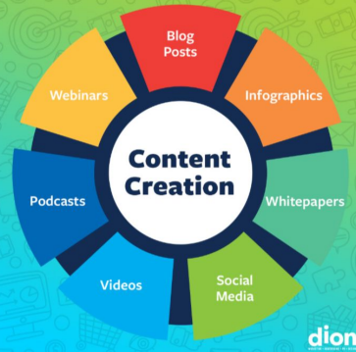
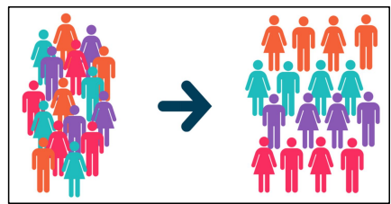
Generative AI in marketing
Abstract and Scope

Slide 9
Generative AI in marketing
Abstract and Scope
Scope :-
● Cost Savings: The project can lead to significant cost savings by automating content creation, SEO, and marketing segmentation tasks, which can otherwise consume a large portion of the marketing budget.
● Return on Investment (ROI): According to Deloitte reports, 82% of early AI adopters have gained financial returns from AI investments, highlighting its financial viability.

Slide 10
Generative AI in marketing
Abstract and Scope
Metadata-Driven Customization: Adapts backgrounds based on product details (color, gender, season, etc.).
Avoidance of Clutter: Uses YOLO v5 to detect and avoid overlapping objects (e.g., people, animals) in the background.
Shadow & Lighting Effects: Adds realistic shadows to the product for seamless blending.

Slide 11
Generative AI in marketing
Suggestions from Phase 2- review 2
Work on prompt engineering to automate prompt generation
Explore on dynamic placement strategies

Slide 12
Generative AI in marketing
Design Approach
Separation of Concerns: The system is divided into clearly defined components—frontend, backend/API gateway, image preprocessor, LLM prompt generator, image generation engine, and output renderer. Each handles a specific task.
Multi-Modal AI Integration: Combines LLM (Mistral-7B-Instruct) for text generation and a diffusion model (Stable Diffusion) for image generation.
Cloud & GPU Utilization: Leverages cloud-hosted GPU ( P100) for efficient image generation.
Collaborative Loop: Allows marketer input (upload, tweak) while maintaining automation in the core pipeline.

Slide 13
Generative AI in marketing
Design Constraints, Assumptions & Dependencies
Constraints :
Computational Resources (GPU Constraints)
Generative models need GPU acceleration. Requires deployment on GPU-enabled environments; cost may limit scale.
Image Size and Resolution
Input images are low-res (60x80 px). Limits output quality; may need upscaling post-processing.
Model Size and Memory Requirements
Mistral-7B is memory-heavy. Backend must manage memory efficiently; may require smaller models.

Slide 14
Generative AI in marketing
Design Constraints, Assumptions & Dependencies
4. Real-time Response Expectation
Users expect quick generation. Needs async processing or task queues to reduce delays.
5. Data Privacy and Security
Must comply with data laws (e.g., GDPR). Requires sanitization, encryption, and ethical data handling.

Slide 15
Generative AI in marketing
Design Assumptions :
Users Will Provide Basic Descriptions or Metadata
Availability of Pretrained Models Assumes access to pre-trained, publicly available Mistral and Stable Diffusion models for fast prototyping and cost-effective deployment.
Brand Guidelines are Provided in Text Format Assumes branding info (tone, colors, voice) is available and structured enough to be parsed by the system.
Design Constraints, Assumptions & Dependencies

Slide 16
Generative AI in marketing
Design Constraints, Assumptions & Dependencies
Design dependencies and impact
Mistral-7B LLM: Used for prompt generation; high compute needs may require fallback models.
Stable Diffusion: Generates ad images; needs GPU and high-quality inputs for best results.
OpenCV: Handles image segmentation; accuracy impacts visual output quality.

Slide 17
Generative AI in marketing
Design Constraints, Assumptions & Dependencies
Design dependencies and impact
Frontend Frameworks (React/Vue): Builds the UI; updates or deprecated libs can affect stability.
User Engagement Analytics: Optimizes via feedback; must handle data volume and comply with privacy laws.

Slide 18
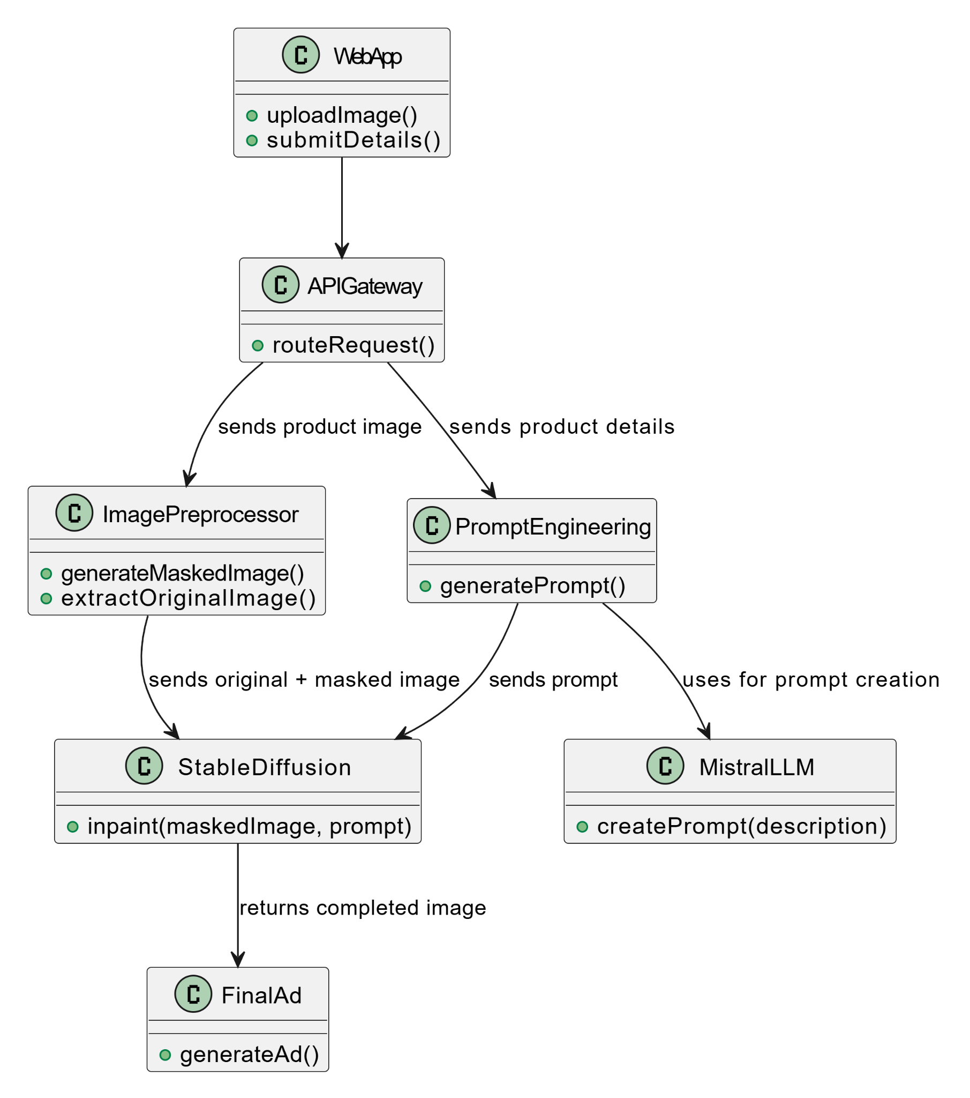
Generative AI in marketing
Design Description
Master Class Diagram

Slide 19
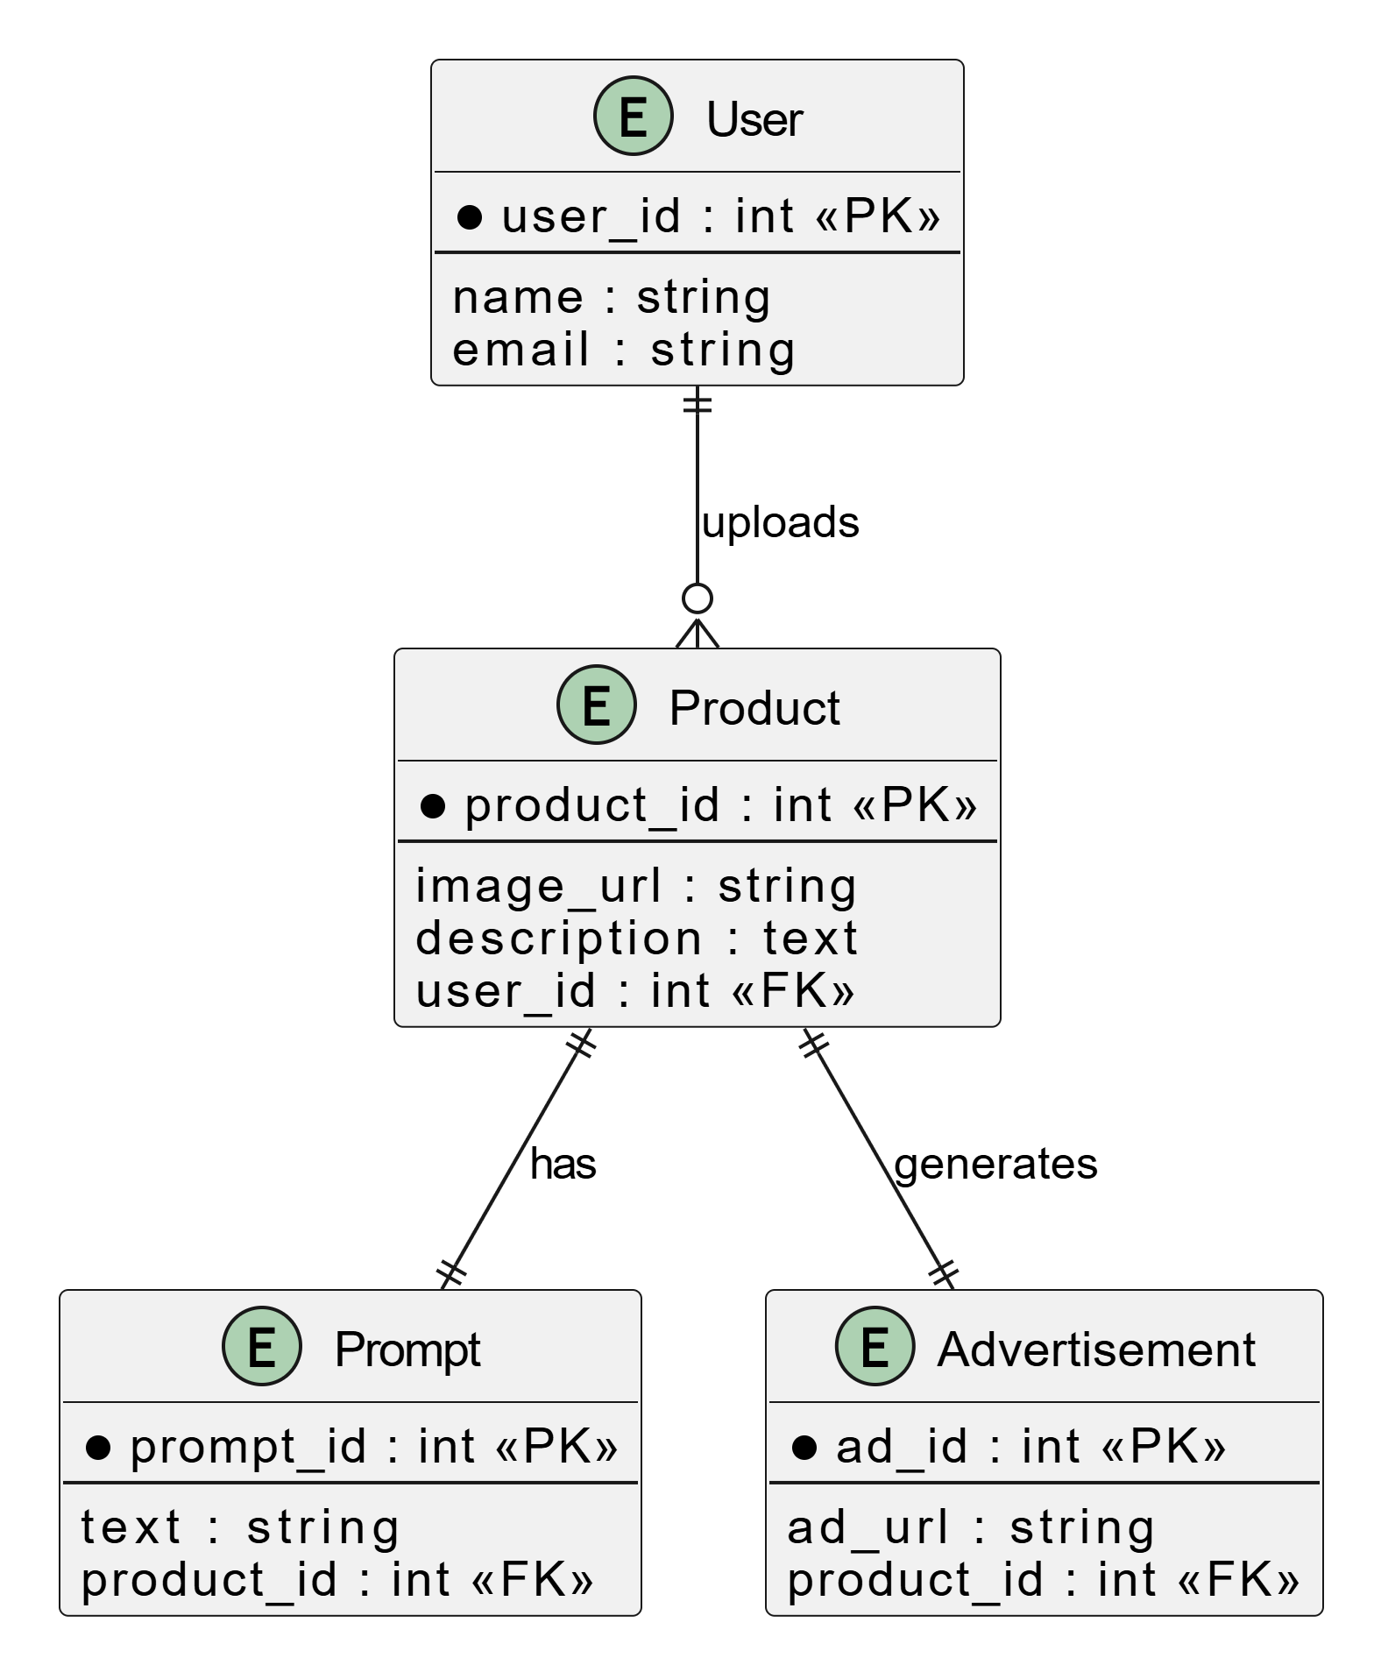
Generative AI in marketing
Design Description
ER Diagram

Slide 20
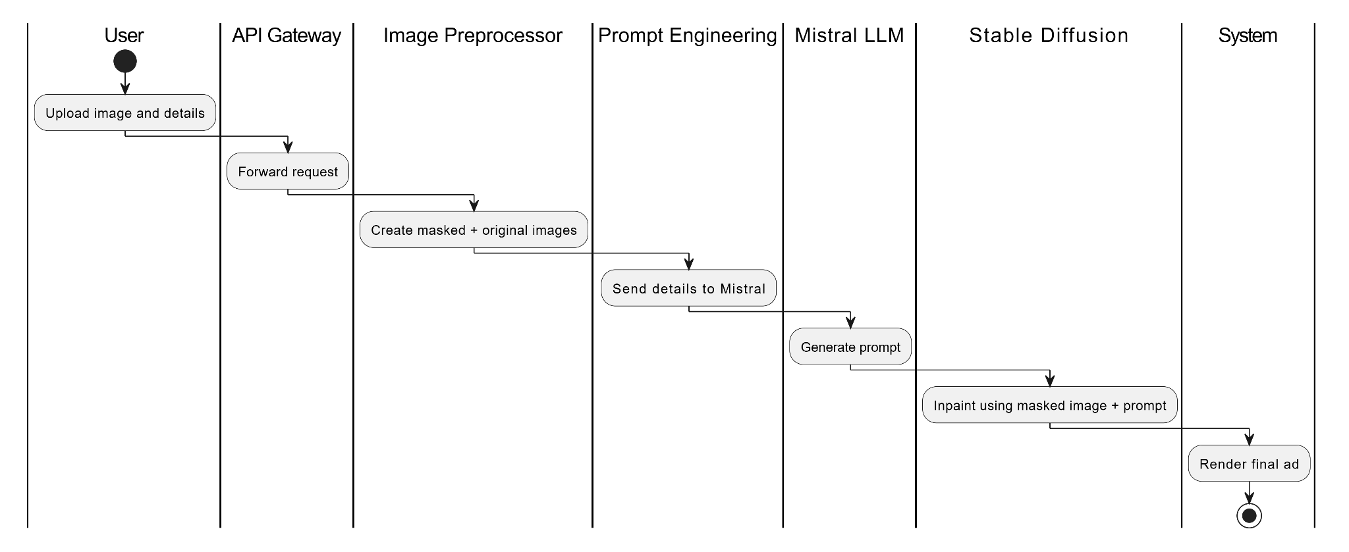
Generative AI in marketing
Design Description
Swimlane Diagram

Slide 21
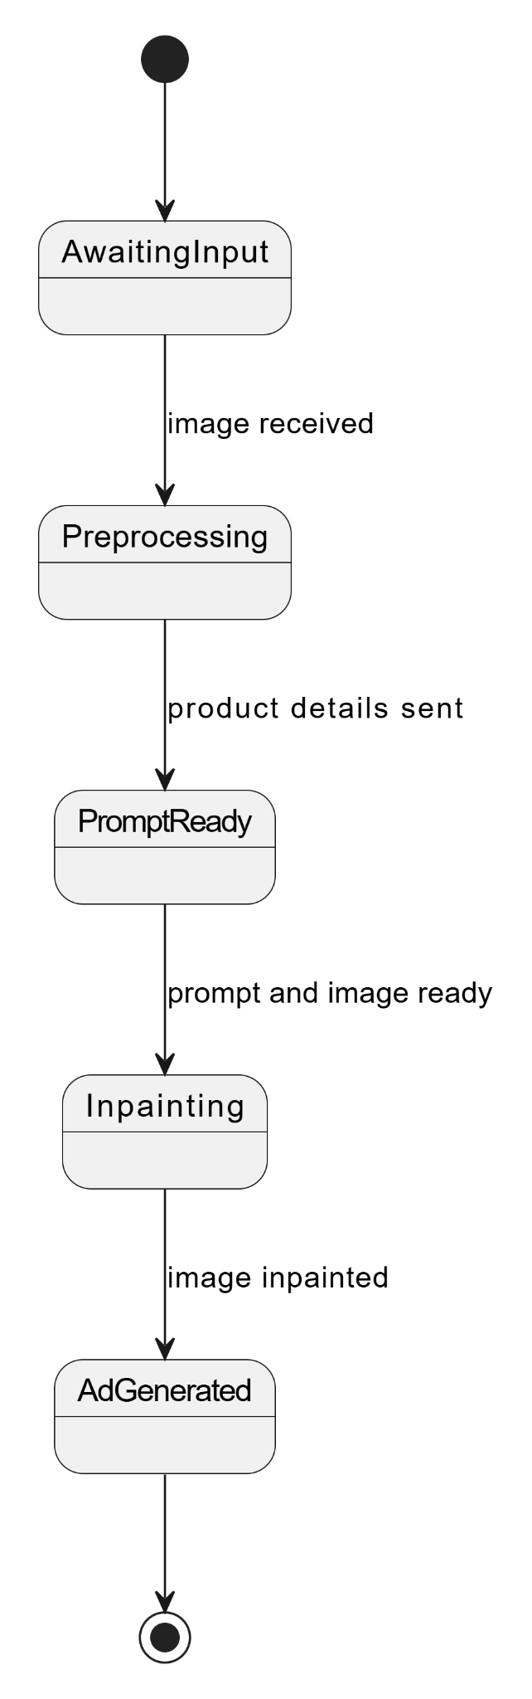
Generative AI in marketing
Design Description
State Diagram

Slide 22
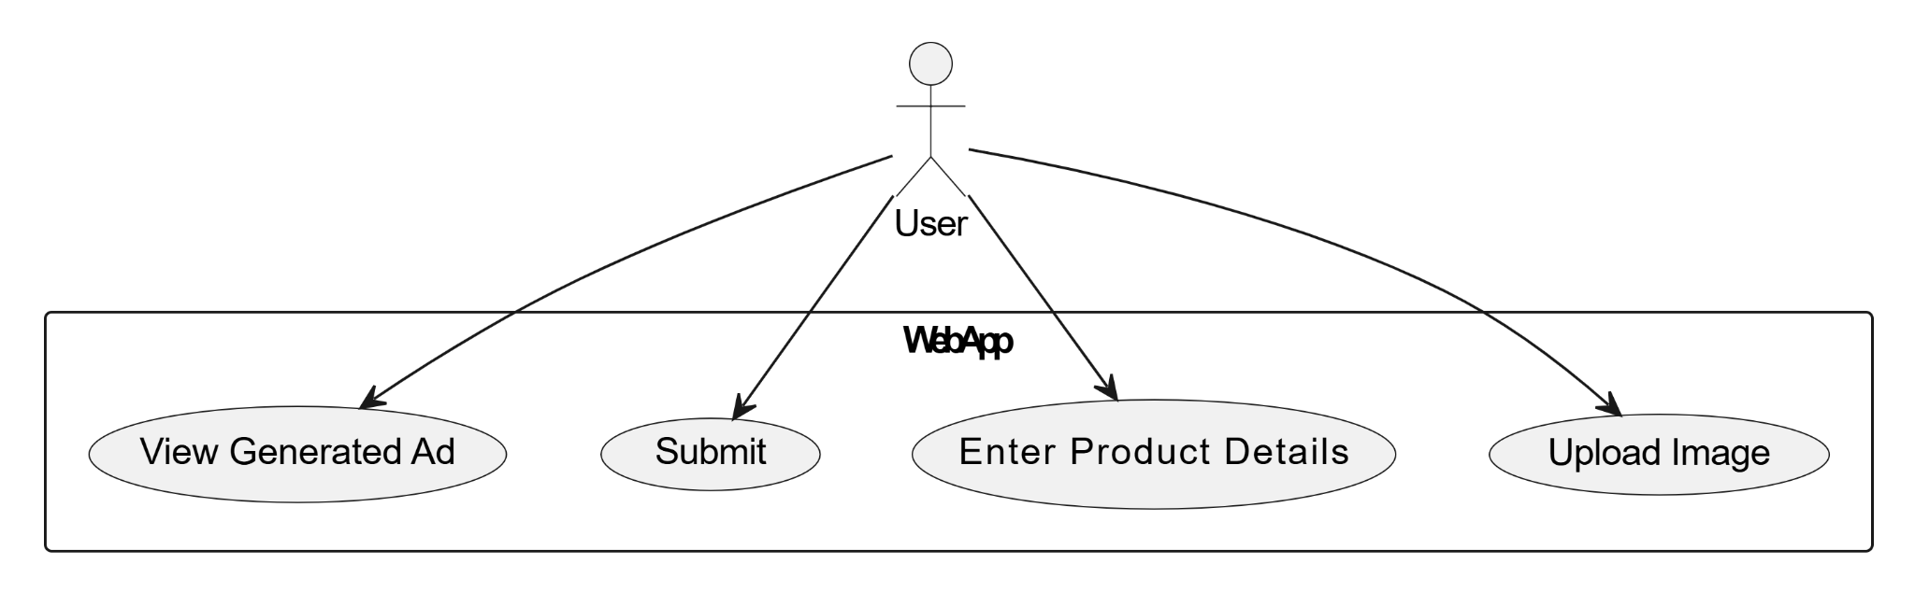
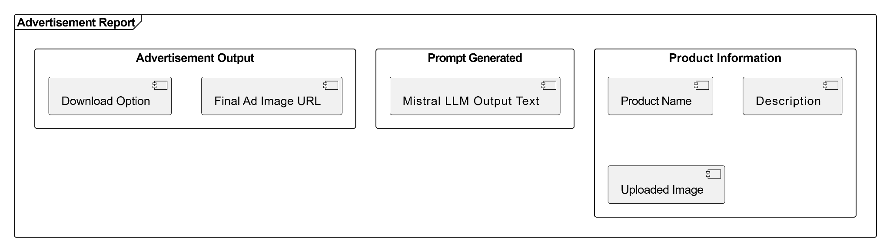
Generative AI in marketing
Design Description
User Interface Diagram
Report layout Diagram

Slide 23
Generative AI in marketing
Design Description
User Interface Diagram
Report layout Diagram

Slide 24
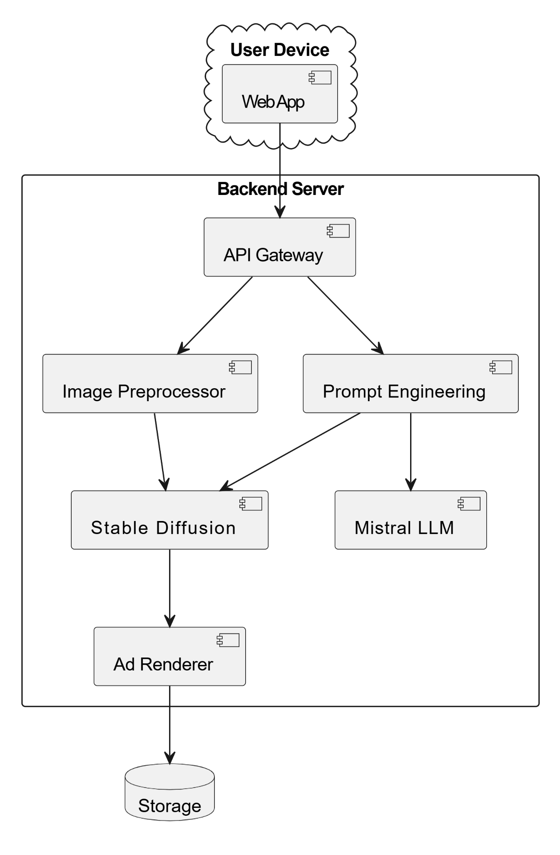
Generative AI in marketing
Design Description
External Interface Diagram

Slide 25
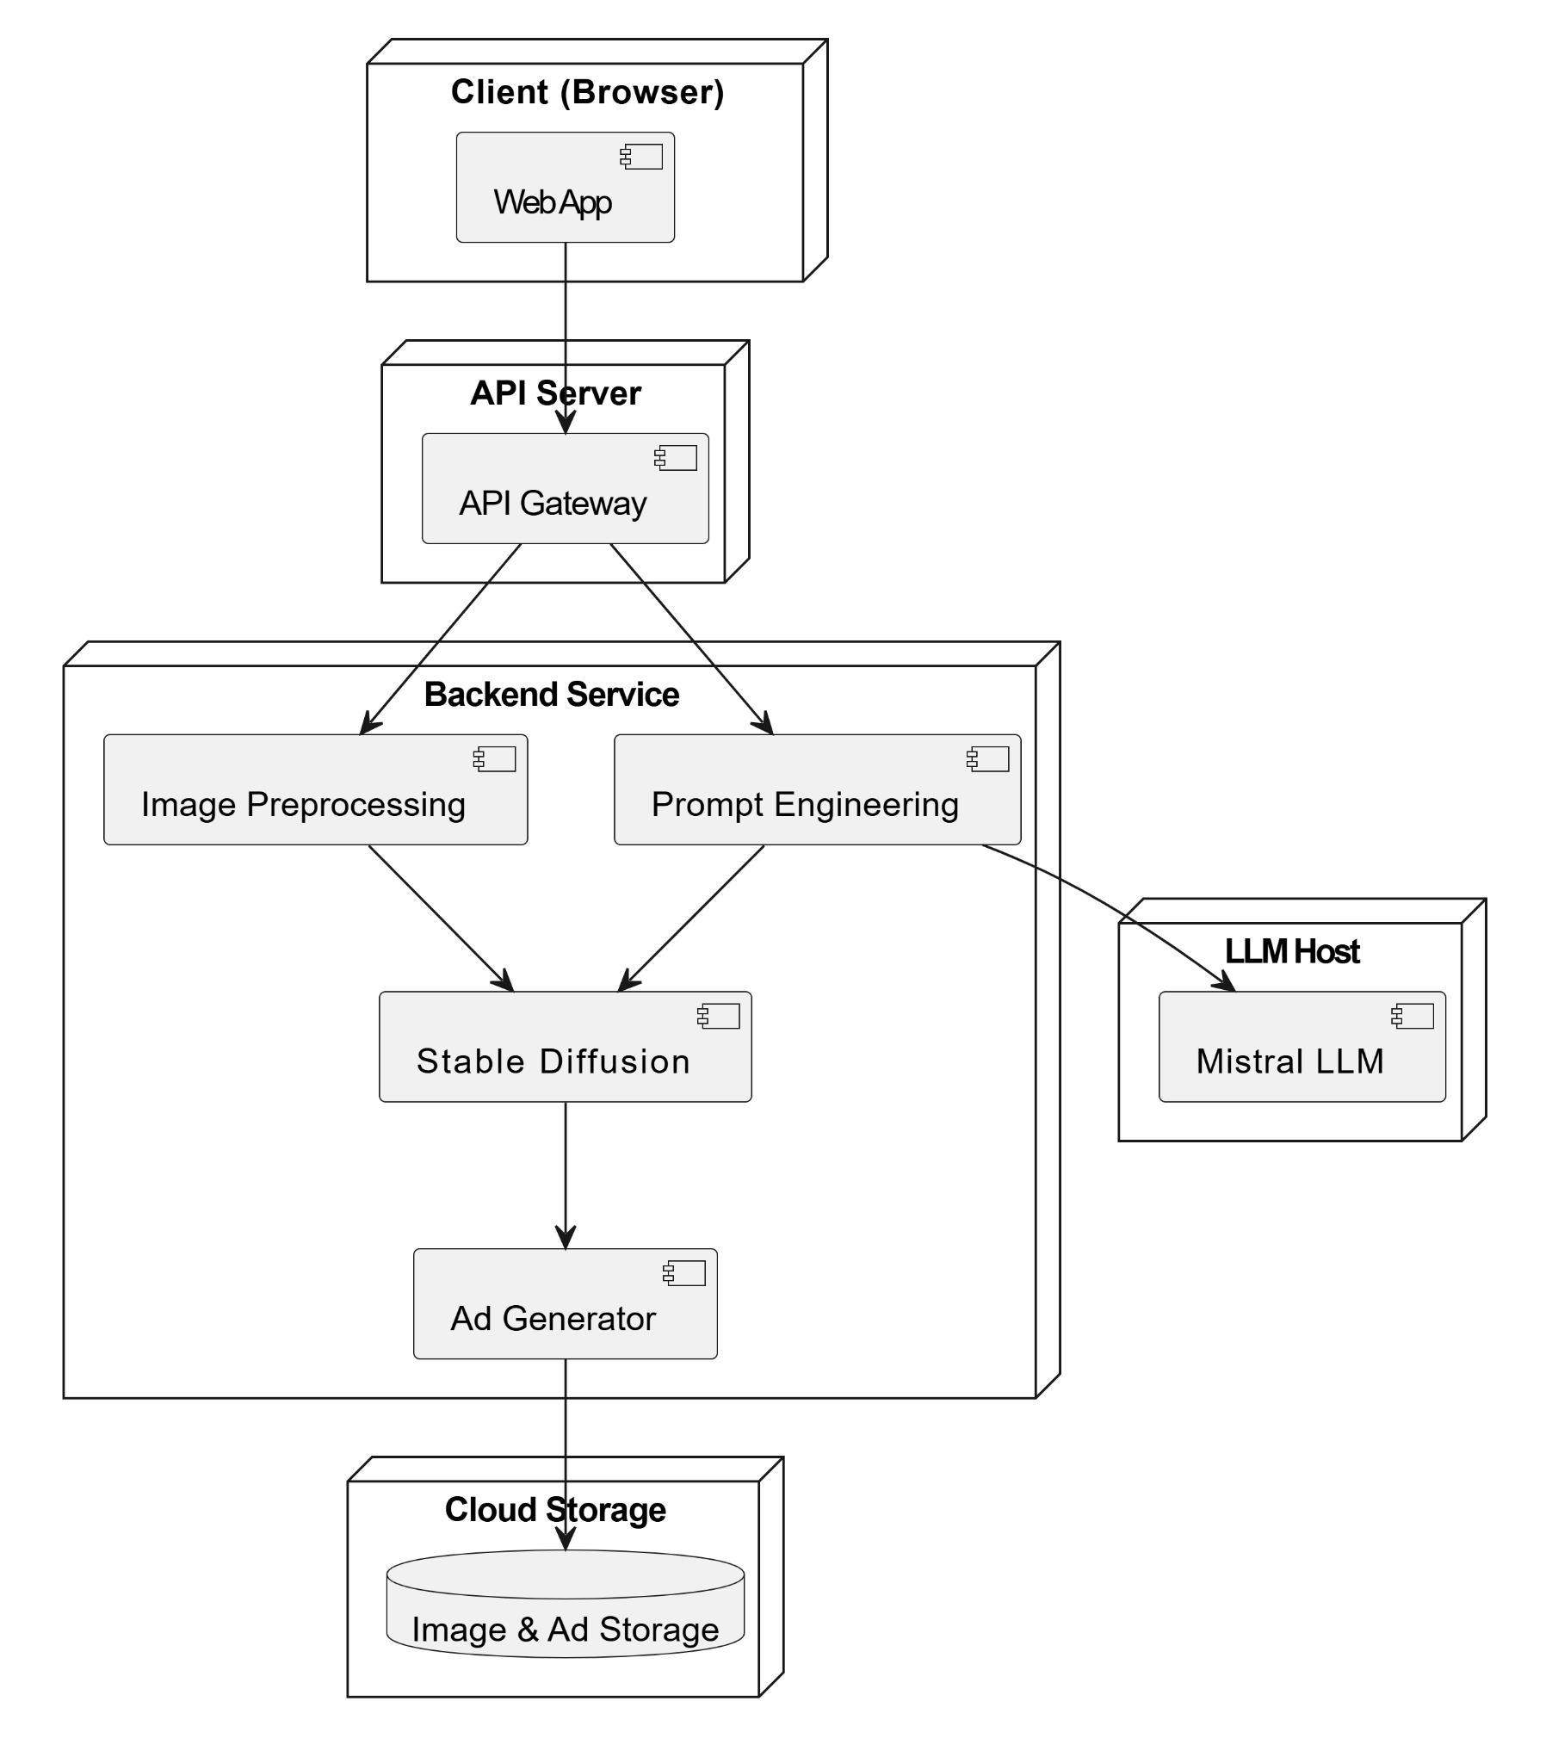
Generative AI in marketing
Design Description
Packaging and Deployment Diagram

Slide 26
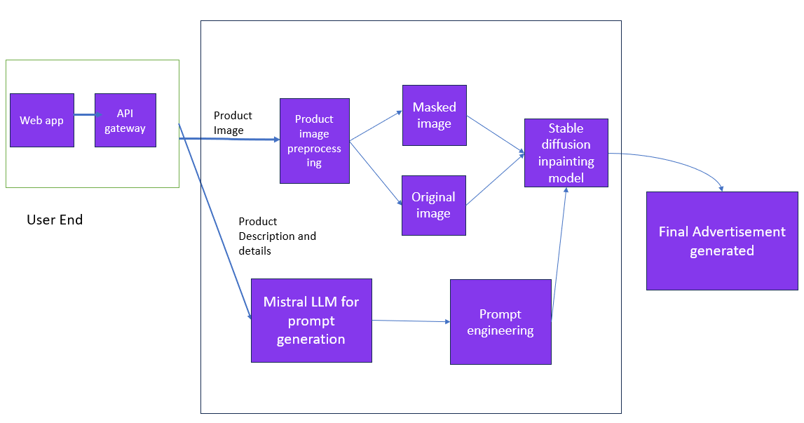
Generative AI in marketing
Architecture

Slide 27


Generative AI in marketing
Proposed Methodology / Approach
1. Background Generation
Used Mistral 7B for prompt engineering based on product metadata (e.g., color, season).
Generated descriptive prompts (e.g., “winter-themed soft blue background”).
Synthesized backgrounds using Stable Diffusion v1-5 (RunwayML).

Slide 28

Generative AI in marketing
Proposed Methodology / Approach
2. Dynamic Product Placement
Background Removal: Used rembg to extract product with transparency.
Object Detection: YOLO v5 avoids placing product over people, animals, trees, etc.
Semantic Segmentation: Simulated sky/ground mapping to guide placement zones.
Scoring Algorithm: Considers brightness, texture, placement bias, and context fit.
Shadow Simulation: Added realistic shadows using PIL for depth and realism.

Slide 29
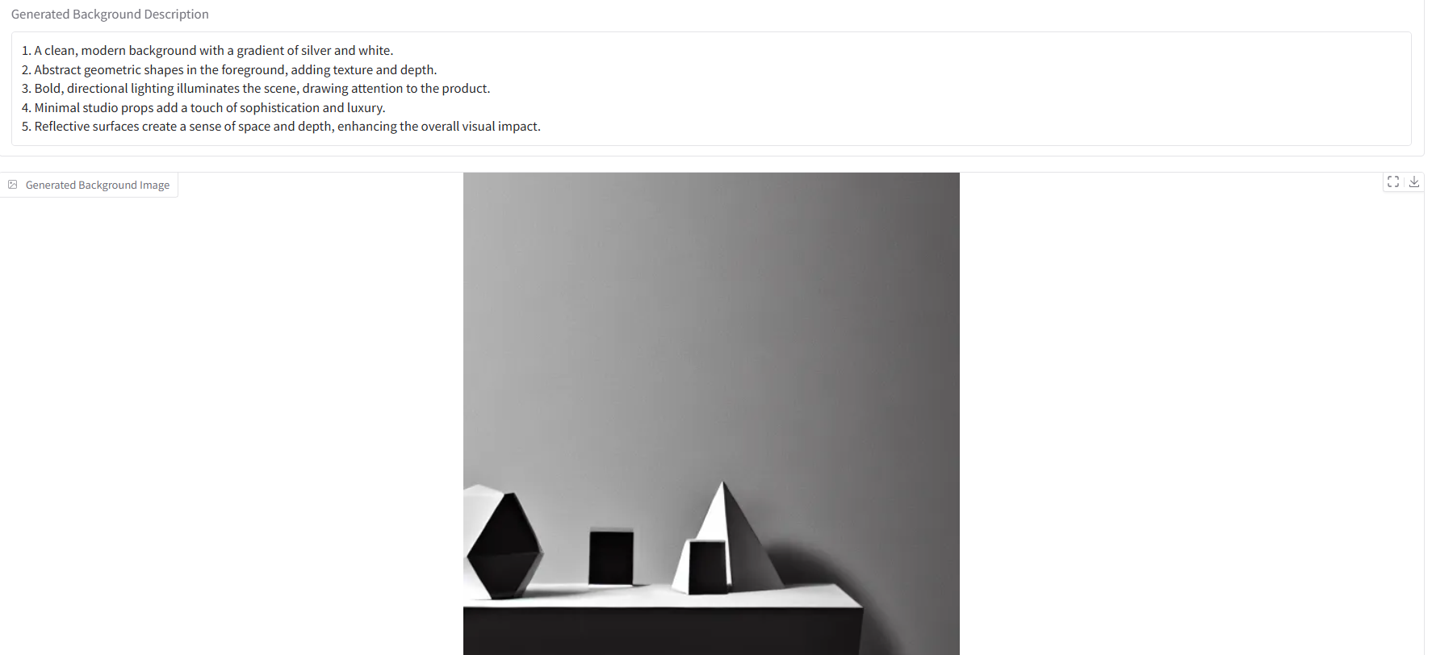
Generative AI in marketing
Proposed Methodology / Approach
3. UI Implementation
Built using Gradio for interactive, shareable interface.
Inputs collected: gender, usage context, color, category, year, etc.
Generates prompt + calls Stable Diffusion for custom background creation.
Ongoing: Enable direct product image uploads and live inlay in UI.

Slide 30
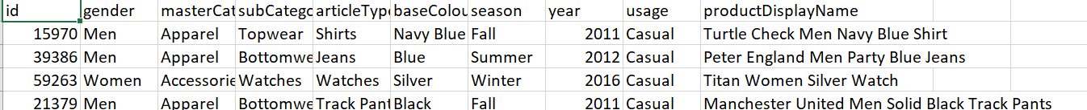



Generative AI in marketing
Currently as a source of inputs to our UI model for prompt and subsequent background generation we are using the following Myntra Products dataset
Datasets Exploration/ Datasets preprocessing
The dataset also has mapped product images -

Slide 31
Generative AI in marketing
Datasets Exploration/ Datasets preprocessing
The data from csv is used to craft contextual prompts that guide the generation of advertisement backgrounds.
Preprocess the image by removing its original background using the rembg library->provides a clean, transparent layer->inlaid into the generated background.

Slide 32
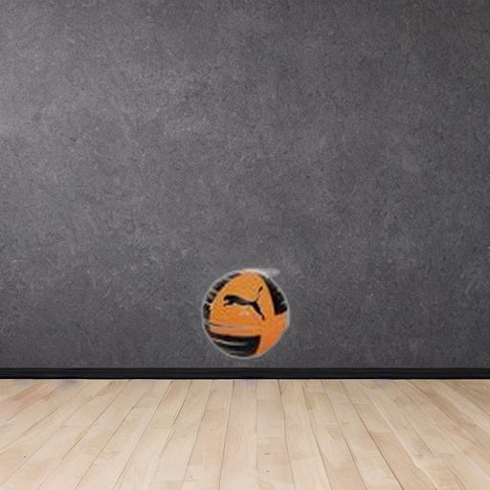
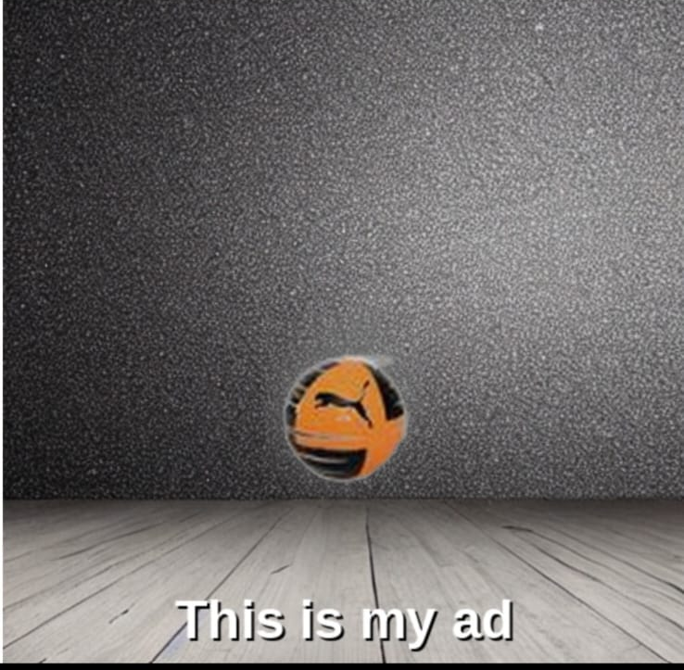
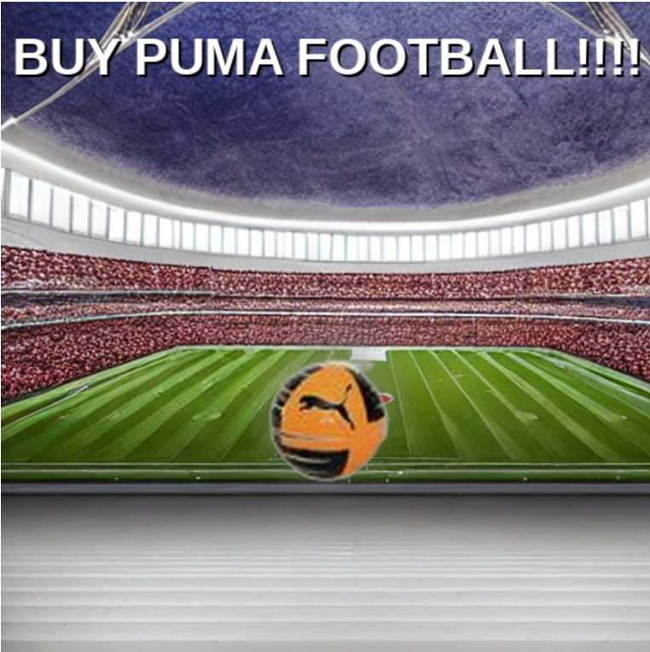
Generative AI in marketing
Level of implementation in previous review
Recap of previous level of implementation progress-
Generated simple background by manually entering prompt
Placement of product restricted to center of background

Slide 33
Generative AI in marketing
Base Model Implementation
Implementation progress-
Automated prompt generation from user input parameters
UI for the same
Product placed smartly by identifying empty spaces(free from background objects)

Slide 34
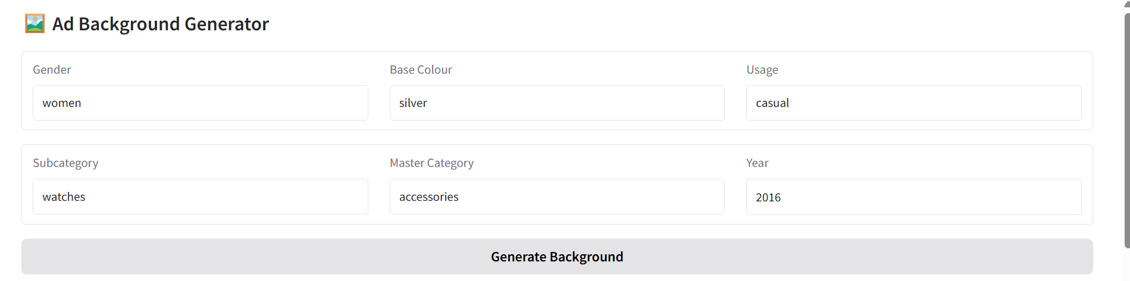
Generative AI in marketing
Base Model Implementation
Basic UI for background generation

Slide 35
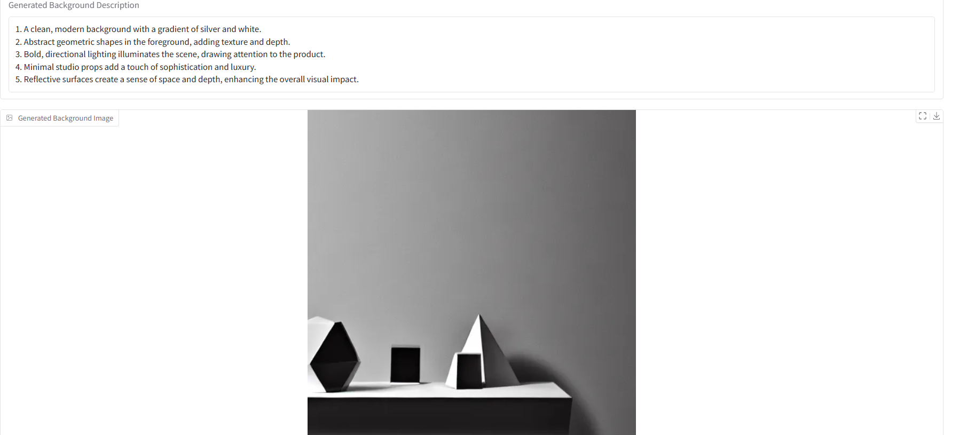
Generative AI in marketing
Base Model Implementation
Basic UI for background generation

Slide 36

Generative AI in marketing
Base Model Implementation
Adding product image post processing and detecting appropriate non-overlap position

Slide 37
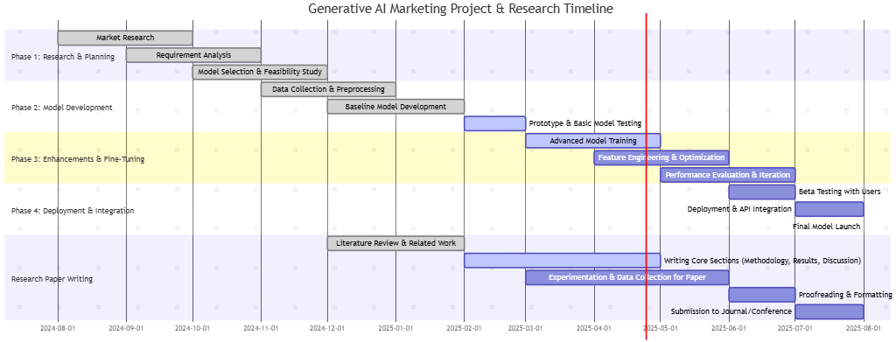
Generative AI in marketing
Gantt Chart

Slide 38
Generative AI in marketing
Project Progress Plan for Phase 3 and Phase 4
Full UI Integration & Workflow Automation i)Enable image uploads and user-defined ad text ii)Streamline entire ad creation in one seamless platform
Support for Additional Visual Elements i)Add characters, props, and brand assets ii)Make ads more engaging and visually rich
Enhanced Background-Product Mapping i)Improve texture, lighting, and perspective matching ii)Ensure more natural, professional ad compositions

Slide 39
Generative AI in marketing
References
[1] A. J.-B. Mazaré, M. Ramé, T. Lamarche, T. Luccioni, D. Simig, G. Ligner, T. Lavril, R. Tallec, T. Schatz, A. Bégué, and G. Lample, “Mistral 7B,” arXiv preprint arXiv:2310.06825, Oct. 2023. [Online]. Available: https://arxiv.org/abs/2310.06825
[2] R. Rombach, A. Blattmann, D. Lorenz, P. Esser, and B. Ommer, “High-Resolution Image Synthesis with Latent Diffusion Models,” arXiv preprint arXiv:2112.10752, Dec. 2021. [Online]. Available: https://arxiv.org/abs/2112.10752​GitHub+8
[3] P. Sahoo, A. K. Singh, S. Saha, V. Jain, S. Mondal, and A. Chadha, “A Systematic Survey of Prompt Engineering in Large Language Models: Techniques and Applications,” arXiv preprint arXiv:2402.07927, Feb. 2024. [Online]. Available: https://arxiv.org/abs/2402.07927​arXiv+6

Slide 40
Generative AI in marketing
References
[4] J. Redmon, S. Divvala, R. Girshick, and A. Farhadi, “You Only Look Once: Unified, Real-Time Object Detection,” arXiv preprint arXiv:1506.02640, May 2016. [Online]. Available: https://arxiv.org/abs/1506.02640
[5] S. Witteveen and M. Andrews, “Investigating Prompt Engineering in Diffusion Models,” arXiv preprint arXiv:2211.15462, Nov. 2022. [Online]. Available: https://arxiv.org/abs/2211.15462
[6] M. S. Seyfioglu, K. Bouyarmane, S. Kumar, A. Tavanaei, and I. B. Tutar, “DreamPaint: Few-Shot Inpainting of E-Commerce Items for Virtual Try-On without 3D Modeling,” arXiv preprint arXiv:2305.01257, May 2023. [Online]. Available: https://arxiv.org/abs/2305.01257​
[7] F. R. Perche-Mahlow, A. Felipe-Zanella, W. A. Cruz-Castañeda, and M. Amadeus, “An Inpainting-Infused Pipeline for Attire and Background Replacement,” arXiv preprint arXiv:2402.03501, Feb. 2024. [Online]. Available: https://arxiv.org/abs/2402.03501

Slide 41
Thank You

